Slide 1
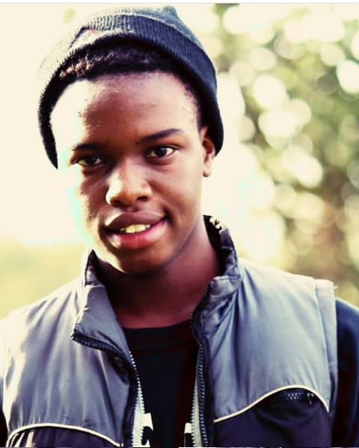
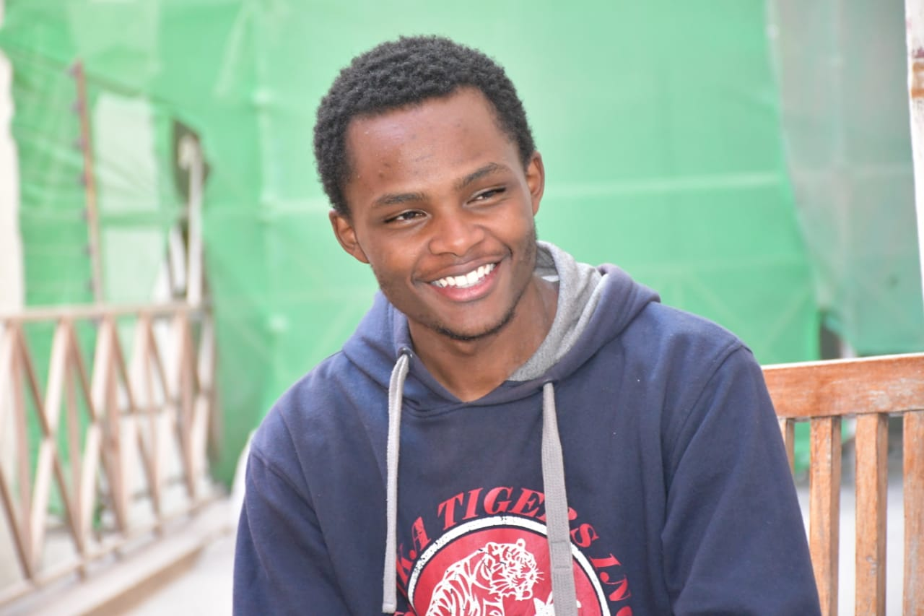

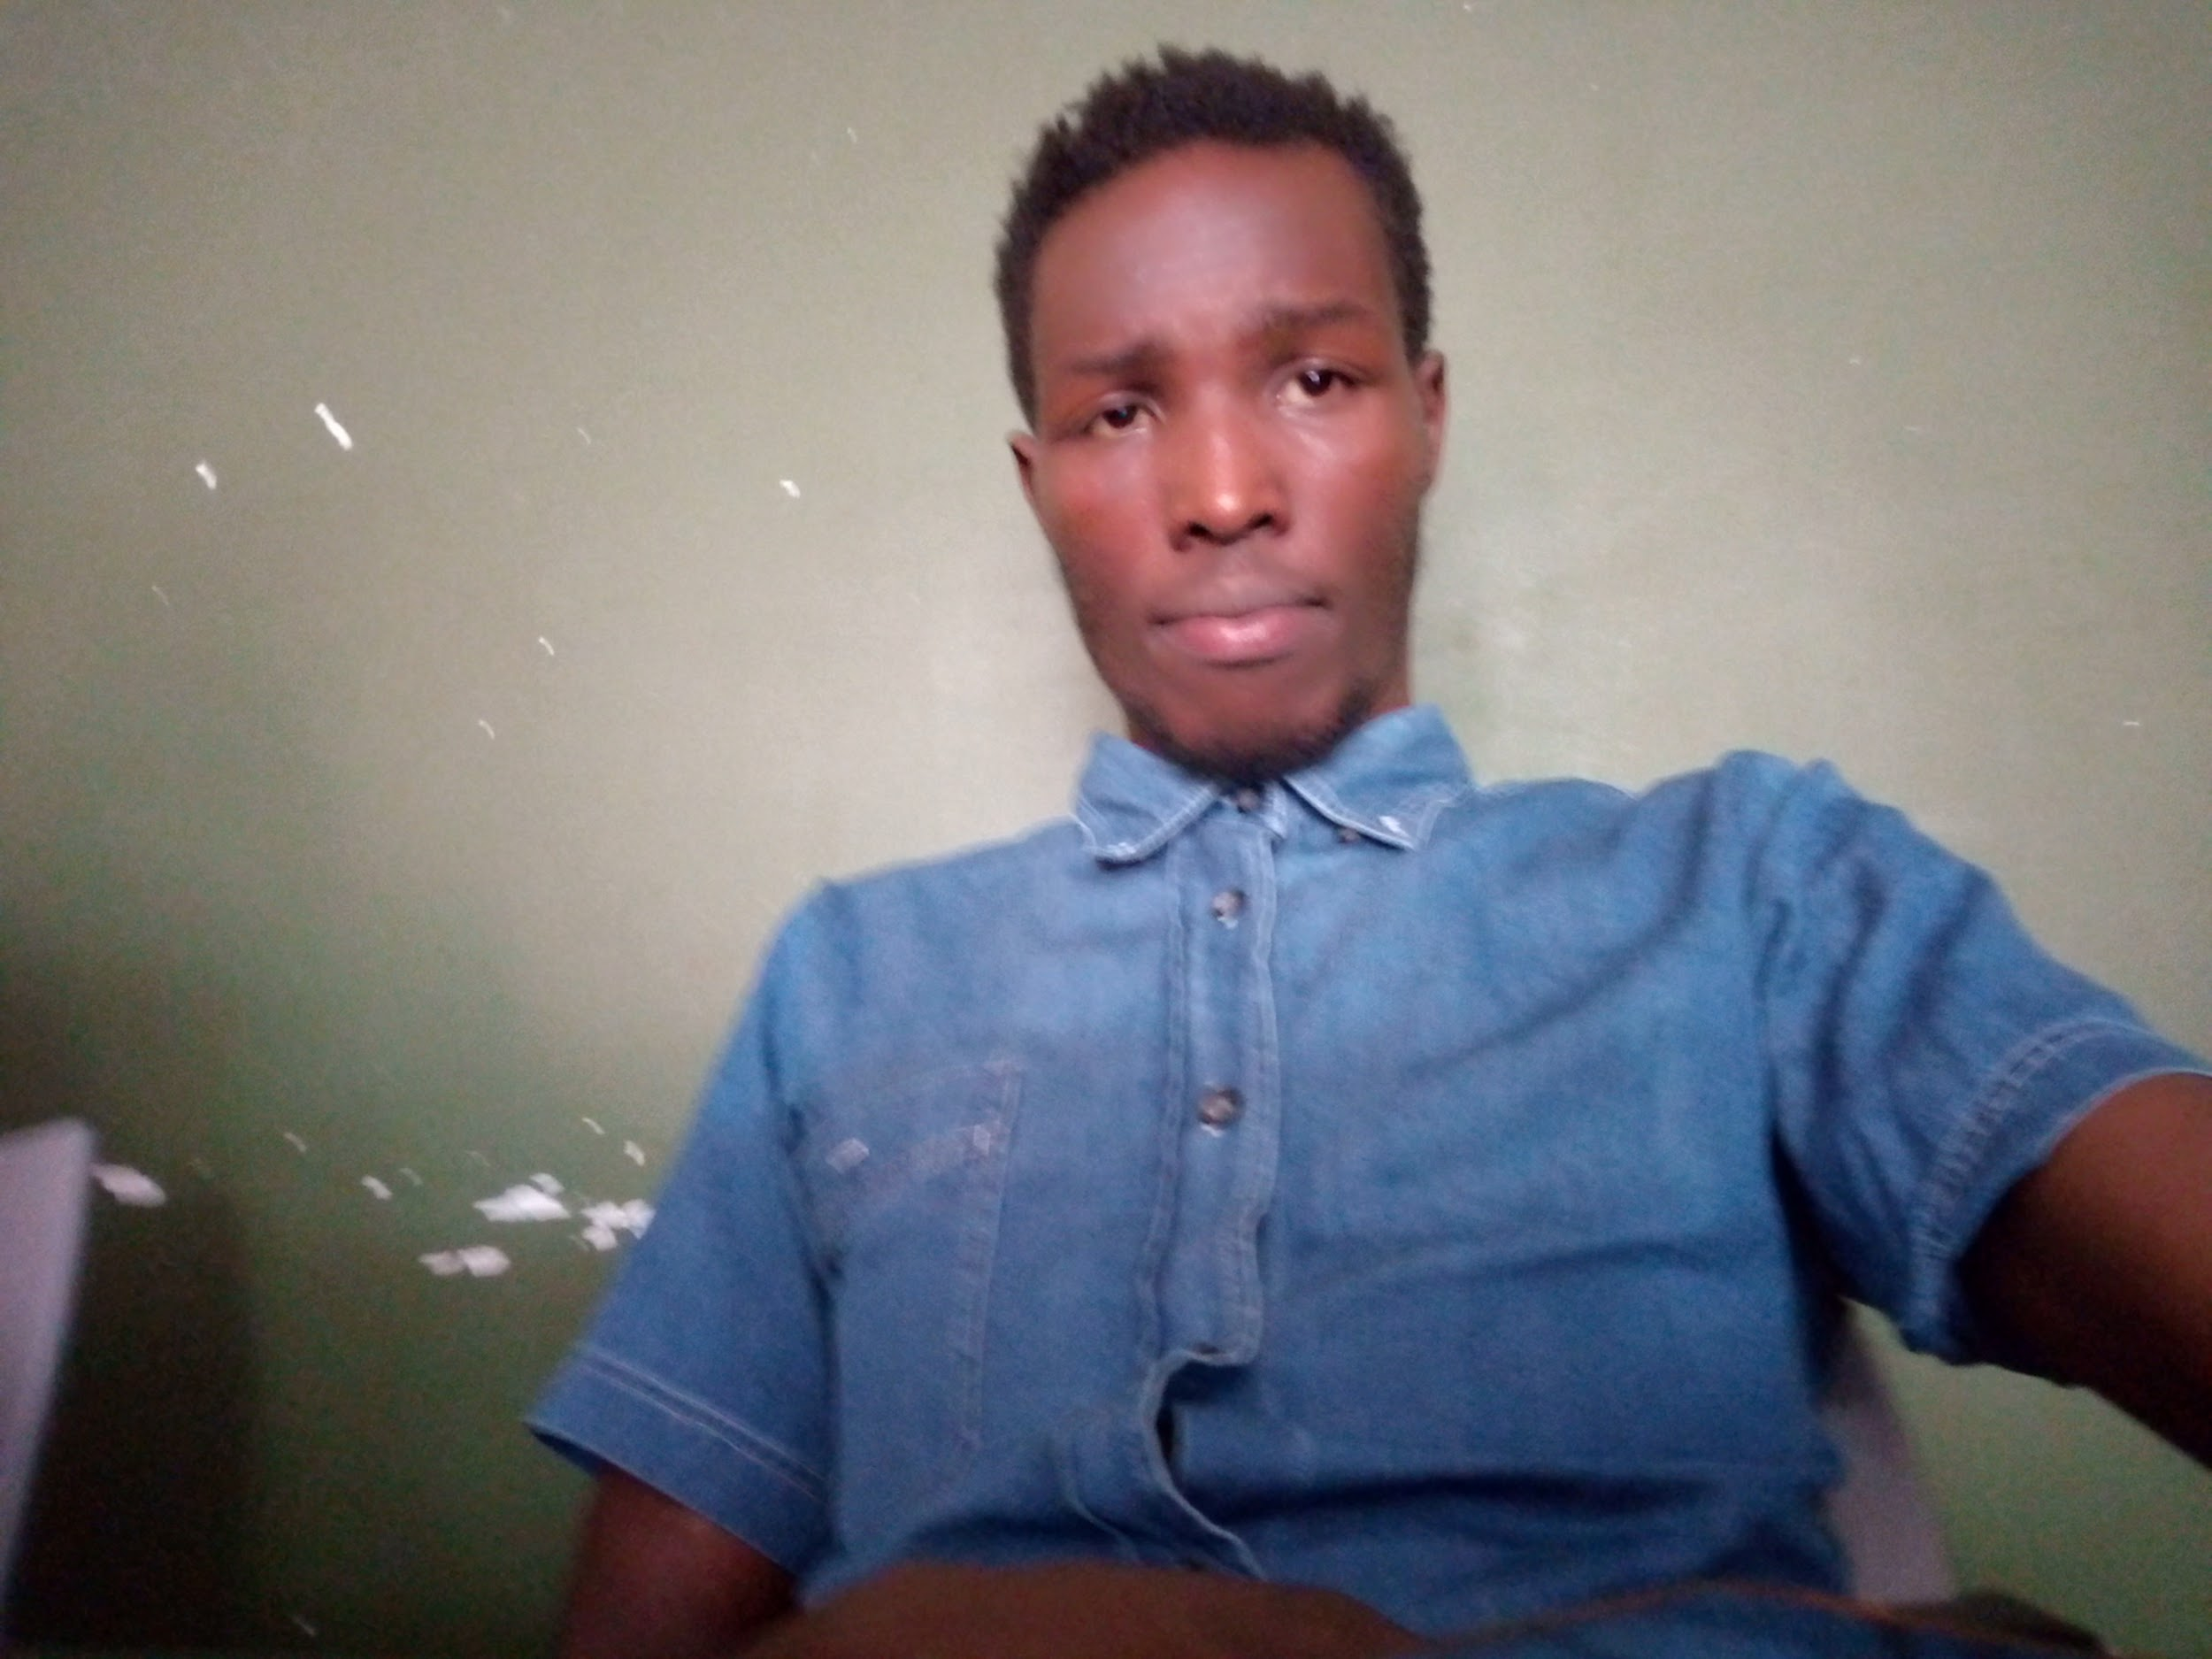
GROUP MEMBERS
RODNEY KINYUA
CHARLES GATERU
DESIRE MMASI
COSMAS ROTICH
BACKEND DEVELOPER
FRONT-END DEVELOPER
SCRUM MASTER
BACK-END DEVELOPER

Slide 2
ON THE MOVE

Slide 3
HAVE YOU EVER HAD AN URGE OF HAVING A CERTAIN GOOD IN THE NICHE MARKET AND STILL OBTAIN AN OFFER FROM IT?

Slide 4
SOLUTION
“Our company aims at providing you with the current product on the niche at an affordable price and also receive an offer from it!”

Slide 5
CHALLENGES FACED
1.Implementing checkout
2.Agreeing on the theme
3.Getting HD photograghs

Slide 6
THANK YOU
QUESTIONS AND FEEDBACKS ARE WELCOME

